Slide 1
2025 IAMSE Meeting Calgary, June 14th to 17th
Martin Schmidt, Reporting as COM Curriculum Fellow

Slide 2

What is IAMSE, and why you should join
International Association of Medical Science Educators
Started 1988 as a special interest group of basic science educators of the AAMC Central Group of Educational Affairs, official start 1997
DMU has been very involved since inception:
Pat Finnerty Lifetime Achievement award awarded to Pat Finnerty (2014), Nehad El-Sawi (2021)
Medical Educator Fellowship completed by Wayne Wilson (2014), Maria Barnes (2022), Martin Schmidt (2022)
Medical Educator Fellowship mentors: Maria Barnes, Martin Schmidt
IAMSE provides professional development, grant support and networking opportunities
Scholarship and curricular innovation grants (1/15/26)
Toolkits, medical educator fellowship, workshops, seminars

Slide 3
Integrating Generations: Are We Ready for the Next 25 Years of Health Professions Education?”
Intergenerational Collaboration
Preparing educators and institutions to bridge generational divides in learners, faculty, and leadership.
Technology Integration
Embracing emerging tools and platforms to enhance teaching, assessment, and student engagement.
Evidence-Based Innovation
Promoting research-informed, learner-centered approaches to curriculum design and delivery.
Interdisciplinary and Collaborative Learning
Encouraging cross-professional teamwork and integrated learning experiences.

Slide 4
Keynotes
Will Bynum (Duke University): The Transformative Power of Shame
Shame as a hidden yet transformative force in medical education
Develop “shame competence” to help learners and educators engage with it constructively.
Yvonne Steinert (McGill University): Preparing for the Future
Faculty development as a key strategy for cultivating adaptive expertise, inclusive practices, and professional identity to prepare medical educators for the next 25 years.
Patricia O’Sullivan (UCSF): The Scholarly Commuter Community
Embrace the mindset of a commuter—navigating between personal preparation and the diverse practices of the health professions education community.

Slide 5
Oral Presentations – Recurrent Themes
Innovations in Assessment
Focused on student progress, workplace-based assessment, narrative feedback, and AI-enhanced evaluation.
Curriculum Transformation
Addressed integration of basic and clinical sciences, competency-based education, and curricular mapping.
Faculty Development & Identity Formation
Explored professional identity formation, mentoring, and inclusive faculty development strategies.
Interprofessional Education (IPE)
Strong emphasis on collaborative learning across disciplines, with case studies and implementation models.
Technology & AI in Education
Sessions highlighted AI in assessment, virtual reality, and digital tools for engagement and feedback.
Student Well-being & Belonging
Several presentations tackled psychological safety, resilience, and inclusive learning environments

Slide 6
Oral Presentations – Hot Topics
AI-Powered Assessment Tools
Growing interest in how artificial intelligence can support formative and summative assessment.
Narrative Feedback & Reflection
Shift from numeric scores to richer, learner-centered feedback models.
Shame & Psychological Safety
Inspired by plenary themes, many sessions explored emotional dimensions of learning and teaching.
Competency-Based Medical Education (CBME)
Continued momentum in implementing CBME frameworks and evaluating outcomes.
Integration of Generations
Reflecting the conference theme, generational perspectives in teaching and learning.

Slide 7
Poster Themes
AI and Technology Integration:
Exploration of artificial intelligence, virtual reality, and digital platforms in curriculum design, assessment, and learner engagement.
Assessment Innovation
Emphasis on authentic, formative, and competency-based assessment strategies, including workplace-based assessments and narrative feedback.
Interprofessional and Inclusive Education
Focus on collaborative learning across disciplines and efforts to enhance diversity, equity, and inclusion in health professions education.
Faculty Development and Well-being
Initiatives targeting educator resilience, teaching effectiveness, and leadership training in academic medicine.
Curricular Reform and Student-Centered Learning
Projects addressing curricular redesign, active learning, and personalized educational pathways to support learner success.

Slide 8
Notable Posters
Using AI for Curriculum Mapping: Tagging Keywords to Learning Objectives (Becker, UWisc)
AI accurately tagged basic science learning objectives (~70% agreement with faculty) but struggled with non-basic science content.
Faculty reviewers showed low consistency in corrections, raising questions about what constitutes “accurate” tagging.
Further refinement, such as adding keyword definitions, may improve AI performance.
Enhancing Medical Education with ScholarRx: Faculty Perceptions on Benefits, Limitation, and Future Potential (Stomberger, USC)
ScholarRx was seen as efficient, versatile, and helpful for teaching and Step 1 prep, though usage varied by discipline.
Faculty valued its multimodal resources but noted integration challenges; most expressed interest in expanding its use within the formal curriculum.

Slide 9
The Faculty Vibe
Discussion of AI technology shifting from “endless possibilities” to “responsible use”
Students are sensitive to faculty not doing their job (i.e., outsourcing educational responsibility)
Resource constraints in developing countries deepen the disparities in health education: AI is becoming quite expensive to acquire and run
Faculty roles must change
Less content delivery, more content selection and authentic assessment of learning. Why pay for recorded content and individualized advice if it’s free on the internet?
Educational vendors struggle to remain relevant
Why buy an expensive subscription when AI-Board prep is just as good? Or is it?
Textbooks have been pirated to train the LLMs, sales are falling.
New US Medical Schools are recruiting aggressively
Struggling to attract talent to new campuses and schools (both faculty and students)
No, I don’t want to move to [your new school], please stop asking

Slide 10
Preparing for the Next Generation of Learners
Students are less well prepared, and this is not reflected in academic metrics
Undergraduate grades are inflated, MCAT scores are normalized
More seats in medical schools but steady/shrinking number of qualified graduates (demographic cliff)
Growing need for pre-matriculation interventions and remediation
Post-COVID Social Isolation in Students
Many students, especially males, are struggling with loneliness and reduced social skills due to prolonged isolation during the pandemic.
Growing need for intentional support in rebuilding peer connections and emotional well-being.

Slide 11
Focus Session: Gamification in Medical Education
Schmidt M: A Question-of-the-Day Game for Medical Biochemistry: Fun, But Only Marginally Effective for Learning and Engagement

Slide 12
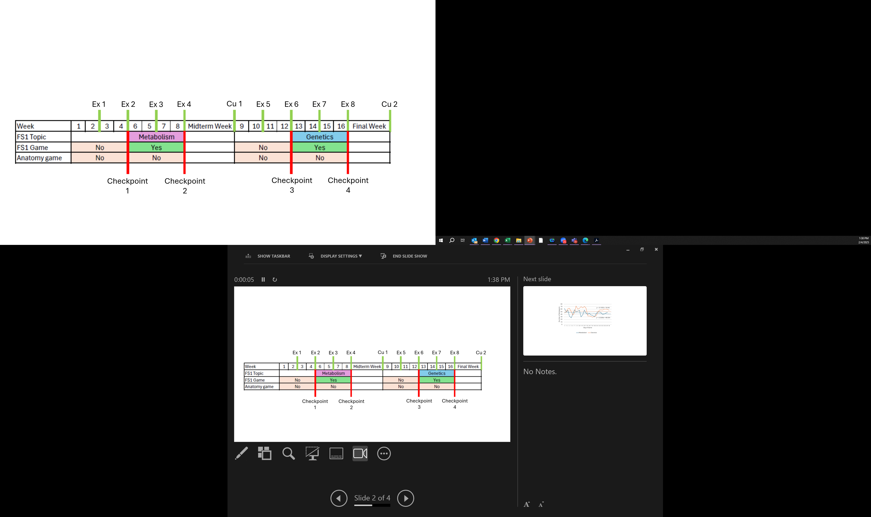
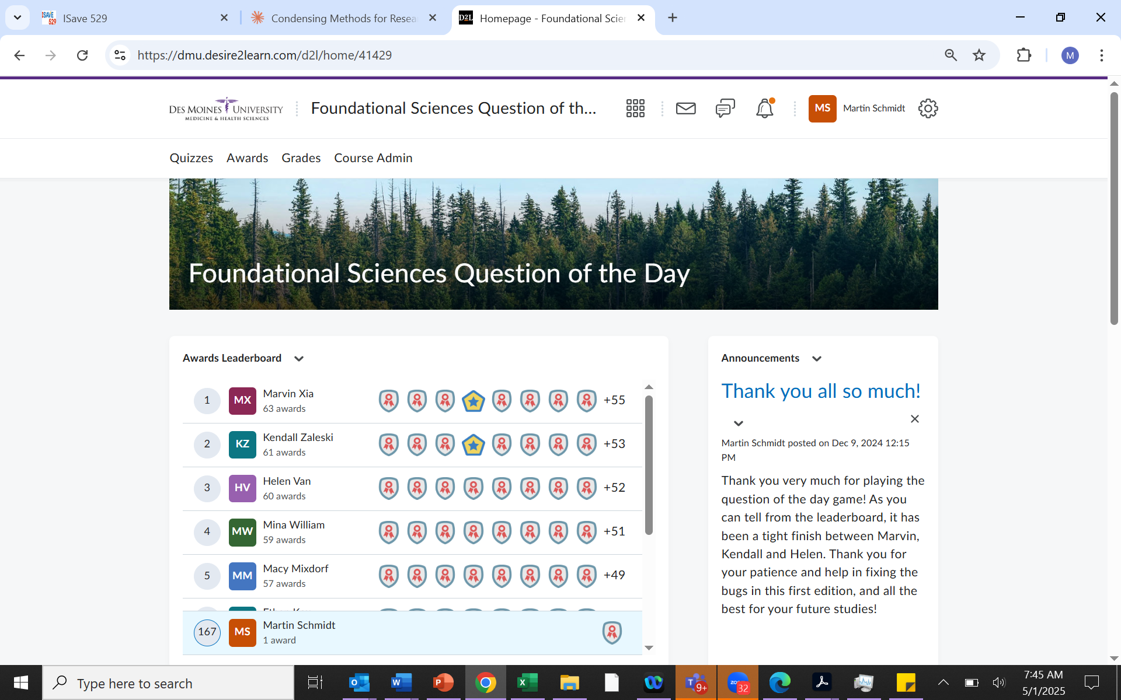
Seeking Solid Evidence: Design of a Question of the Day Game
Build two 28-day games to accompany metabolism and genetics modules
Population: Students in First year Foundational Sciences 1 course at Osteopathic Medical School
Intervention: Daily questions that integrate past and current content (pushed via LMS), badges and leaderboards
Controls: FS1 course sections without game, anatomy course without game
Outcomes – Response, Learning, Behavior
Participation and student comments on survey
Changes in academic performance and engagement with course material from checkpoints 1 to 2 and 3 to 4.
Examine correlation and differences in case-matched cohorts

Slide 13
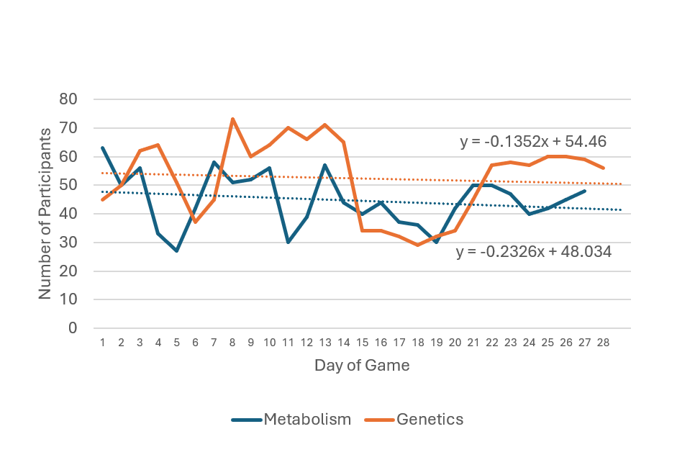
Outcomes: Participation and Reaction
Participation (LMS data)
66% of 236 eligible students answered at least one question
70.3% of first-round participants chose to repeat the game in the second round
Reaction (Survey, N=19)
The game was a good use of study time
Participation increased engagement with course content
The game improved understanding of the course material
Question | Average +/- StDev
Participation in the game was a good use of my study time | 4.7 +/- 0.5
The game increased my engagement with the course | 4.5 +/- 0.5
The game improved my understanding of the material | 4.4 +/- 0.5
The game improved my appreciation of the Foundational Sciences | 4.0 +/- 0.9
The game helped my exam performance | 3.7 +/- 0.7
I found it hard to participate on a daily basis | 3.0 +/- 1.3
Notes:
Discuss: Medical students are looking for efficiency, not entertainment. What use is an entertaining game if it takes five times longer to learn the same concepts? If one requires students to spend more time in one course by adding ineffective yet fun modules, wouldn’t one expect the grades in other courses to drop and overall performance to go down?

Slide 14
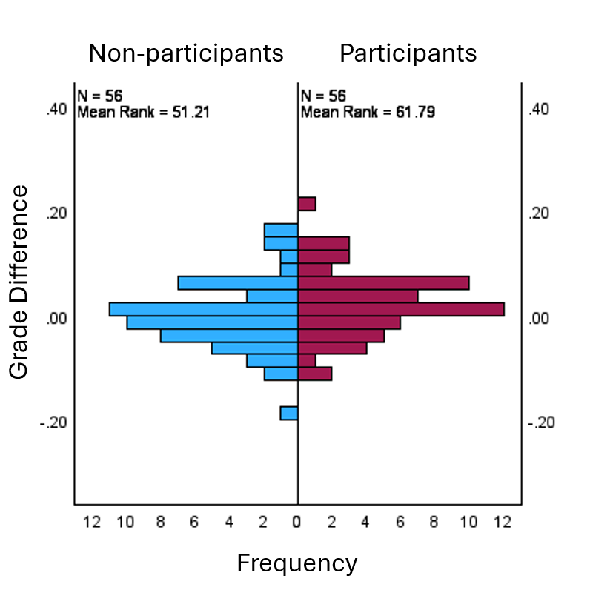
Outcomes: Learning
Correlation of game questions answered with… | R value | p | Classification
Foundational Sciences grade before the game | 0.040 | 0.464 | very weak, not significant
Anatomy (control) grade before game | 0.093 | 0.088 | very weak, not significant
Foundational Sciences grade difference during game | 0.061 | 0.262 | very weak, not significant
Anatomy (control) grade difference during game | 0.059 | 0.279 | very weak, not significant
No significant correlation of game participation and change in course grades
Case-matched cohorts of participants and non-participants show insignificant improvement in course grades (p=0.085)
Non-participants -0.002 +/- 0.08
Participants 0.022 +/- 0.078

Slide 15
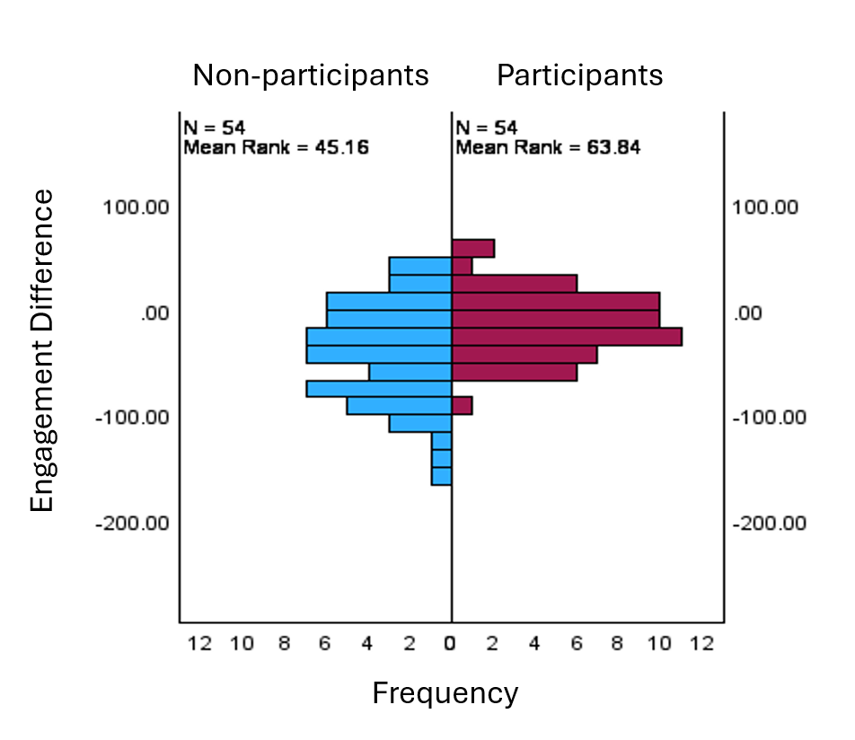
Outcomes: Behavior
Correlation of game questions answered with… | R value | p | Classification
Foundational Sciences engagement before game | 0.226 | <0.0001 | very weak, significant
Anatomy (control) engagement before game | 0.130 | 0.017 | very weak, significant
Found. Sciences engagement difference during game | 0.096 | 0.075 | very weak, not significant
Practice exams taken difference during game | -0.031 | 0.568 | very weak, not significant
Anatomy (control) engagement difference during game | -0.012 | 0.830 | very weak, not significant
Game participation shows no significant correlation with student engagement with foundational sciences content, anatomy content or utilization of practice quizzes
Significantly higher FS1 course engagement in game participants (p=0.012)
Non-participants -39 +/- 69.8 accesses
Participants -12.5 +/- 41.5 accesses

Slide 16
Conclusions and Feedback
Is the question of the day fame fun?
Yes; students like it and participate repeatedly
Is the game a good use of study time?
Subjective: Yes, students think so
Objective: No, learning outcomes are insignificant, no harm in participating (grades do no drop)
Does the game increase engagement with course material?
There is a weak positive correlation, but it is not clear if this is cause or effect
Should you incorporate a question of the day game in your course?
Pros: Students appreciate it, engage more with content
Cons: Takes serious time to build, might increase student stress even if voluntary
Limitations/Feedback
Not a randomized controlled study
Seems to contradict other studies and sincerely held beliefs
Repeat as case-matched study with larger sample size

Slide 17
New Projects Inspired by IAMSE Meeting
Building AI chatbot to conduct formative oral assessments of IPE knowledge
AI has made take-home essays obsolete, live/oral examinations are gaining importance as reliable assessment tools
Oral examinations with individual feedback are prohibitively labor-intensive and notoriously subjective
Build an AI chatbot to replace written essays as evaluation tools for IPE sessions (Schmidt and Satalkar, NSF computing resources grant obtained, Macy grant in prep)
Designing a Treasure-Hunt game for interprofessional learning during clinical clerkships
IPE is often limited to the preclinical curriculum because clinical students are too dispersed to organize interprofessional events
This is a missed opportunity to learn collaboration and counter prejudice
Developing a game during which students conduct structured interviews with different health professions for points, leaderboard placement and IPE badge credit

Slide 18

IAMSE Virtual Forum with Global Outreach

Slide 19

IAMSE 2026 Conference

